Slide 1
Medical Image Encryption by Content-Aware DNA Computing for Secure Healthcare

Slide 2
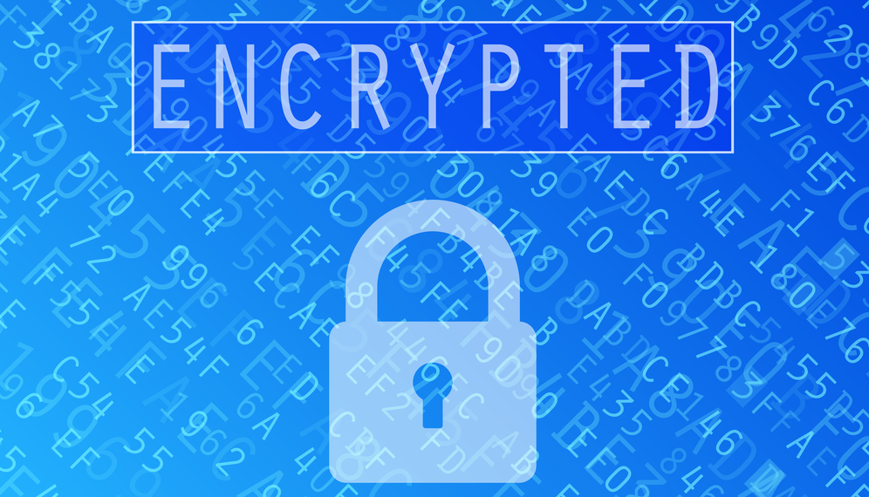
WHY Medical Image Encryption Is Required ?
(a) Healthcare is an attractive target for cybercrime, due to its high value and weak defences. Researchers generally define information lost, stolen, displaced, hacked, or communicated without unofficial recipients as a
cybersecurity breach of healthcare information.
(b)Even small lost, stolen, displaced, hacked, or communicated in personal health data could bring huge damage to patients.
(c) It was reported in a major English newspaper that about 94% of healthcare organizations have experienced at least one cyberattack and 150 million patient health records have been breached between 2009 and 2014.

Slide 3
WHICH ENCRYPTION WE CHOOSE AND WHY?
Among cybersecure solutions for different kinds of cyber threats, we aim to improve security under cryptographic attack, which is carried out with the intention of revealing information that has been encrypted. Aiming to guarantee the security of medical images in the transfer process, an efficient and reliable image encryption system is required.
Some of the famous methods are : Rivest Shamir Adleman (RSA), data encryption standard (DES), advanced encryption standard (AES), and international data encryption algorithm (IDEA)
Since medical images own unique characteristics of strong correlation between adjacent pixels with high redundancy, we prefer special designed image encryption methods.
Due to the promising properties of high speed, parallelism computation, minimal storage,and unbreakable cryptosystms, deoxyribonucleic acid (DNA) computing is adopted to encrypt medical images in the transfer process

Slide 4
GOALS AND OBJECTIVES:
Creating a Consistent and High-Capacity Workflow for Medical Image Encryption: Generally, healthcare professionals prefer smooth workflow with real-time and consistent response to reach the final conclusion in clinical diagnosis. If adopting complicated and annoying image encryption workflow, professionals might resist encryption in transfer process to improve security.
Secure Ability Using Random Mechanism and Image Data for High Complexity: Random mechanism is widely recognized as a means to increase difficulty of cracking. Meanwhile, images themselves recognized as high-dimensional data can be a natural source to bring high complexity.
Producing Content-Aware Encryption for Medical Images: Due to properties of taken devices, medical images generally own strong correlation between adjacent pixels with high redundancy. In other words, local and neighboring pixels share the characteristics of naturally and smoothly varying. Our main focus is to link image content and encryption process for higher complexity.
Building a randomly DNA encoding module to create random mappings between image pixels and computing and a content-aware permutation and diffusion module to construct a content-related permutation sequence, where both modules greatly improve secure ability.

Slide 5
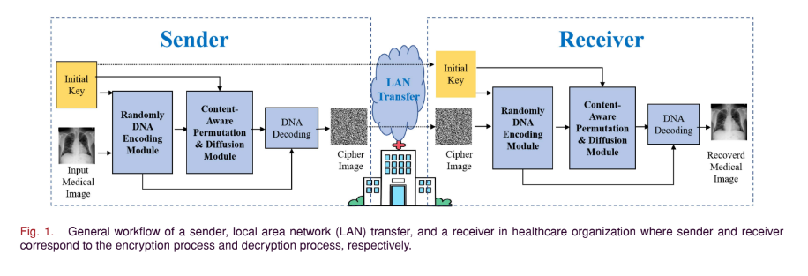
The modules used in the encryption and decryption processes are :
randomly DNA encoding module (b) content-aware permutation and diffusion module
The DNA decoding procedures can be seen as the inverse process of the previous DNA encoding procedures. Therefore, we can notice that both sender and receiver share the same modules.
In the encoding process, we give the medical image and the key(K) as the input and the output is the cipher image.
The cipher image is transmitted to the receiver end from the sender through appropriate channel.
In the decoding process, we give the key(K) and the cipher image as the input and the output is the original image.
.

Slide 6
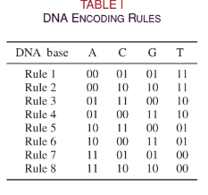
Randomly DNA Encoding Module
The DNA encoding process reconstructs the image data into DNA format for later calculation. The advantage of DNA encoding is that there are several different rules to choose, and we introduce chaotic system, which makes the variety of rules more diverse and elusive.
There are four kinds of DNA bases: 1) adenine (A); 2)guanine (G); 3) cytosine (C); and 4) thymine (T). Adenine and thymine is a complementary pair, while cytosine and guanine is a complementary pair in human genome. In this case, there are totally eight kinds of encoding rules, as per the following table:
The module proposed in this section needs to randomly select different rules for encoding each pixel in the image, so that the encoding is done in a proper and efficient manner.

Slide 7
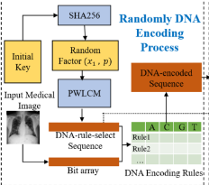
PWLCM stands for “Piecewise Linear Chaotic Map”
The SHA256 algorithm is used to calculate the hash value of the initial key and generate a random factor, which is a necessary initialization parameter for the PWLCM to generate a pseudo random DNA-rule-select sequence. By using this chaotic map, a small change in the initial random factor will lead to huge variation in the generated sequence, which can significant improve the key sensitivity of the cryptosystem. Finally, this sequence is used to establish the mapping between each byte in the image data and the eight different DNA encoding rules.

Slide 8
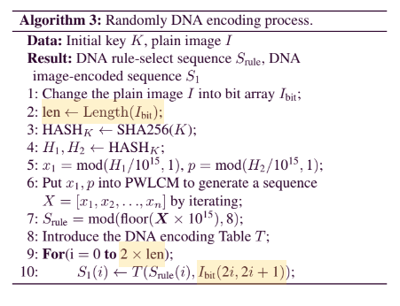
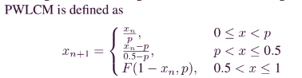
Here the initial input x1 is the random factor and the p ∈ (0, 0.5] is a parameter of PWLCM.
The bit array is created by flattening the original medical image matrix (2-dimensional) into a set of 1-dimensional column vectors. Flattening is done to reduce the dimensionality of the image matrix as it makes our sequence selection process much simpler.

Slide 9
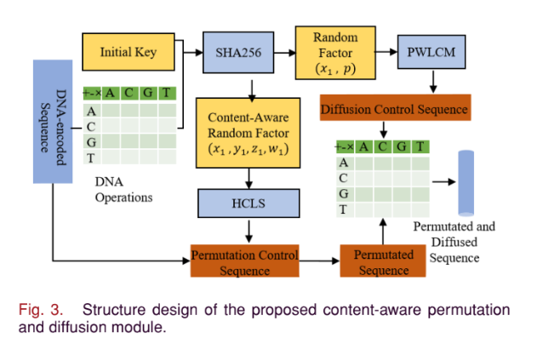
Content-Aware Permutation and Diffusion Module
Permutation and diffusion are two basic methods of symmetric encryption. However, traditional methods either only generate the permutation sequence by the key, where the sensitivity to content is weak, or need to transfer the hash value of the original graph to the encryption part that pose a threat to the security. In contrast, our method take advantage of the reversibility of permutation operation and the commutative law of DNA operation, and cleverly realize the reversible content-related permutation and diffusion without transmitting any data other than the cipher image. It overcomes the shortcomings of both two methods.

Slide 10
The content-aware permutation and diffusion module contains the reversible plaintext-related permutation algorithm and the diffusion algorithm that the information of plain image can be directly calculated in the decryption part without transmitting from the encryption part. These two algorithms take advantage of three types of DNA operations:
1)ADD 2) SUB 3) XOR.
Compared with traditional mathematical and logical operations, these DNA operations contain more diversified forms, which improve the variability of encrypted sequences.
ADD and XOR operations satisfy the commutative law, which means that the result of these operations is exactly the same for the DNA sequence before and after permutation. So, the permutation procedures of the encryption and decryption processes can be realized with the same algorithm and parameters, without transmitting additional data in the LAN. Therefore we are able to increase the efficiency of the process by successfully reducing 2 of the complex operations.
In the permutation procedure, the proposed module first uses XOR and ADD operations to calculate a result (x1, y1, z1, w1) based on initial key K and DNA-encoded sequence S1. Then we provide this result into the Hyperchaotic Lorenz System (HCLS) to generate a content-aware permutation control sequence Sp.

Slide 11
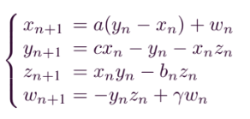
The HCLS is given by:
Where a, b, c, and γ are the parameters of HCLS, and the system is chaotic when a = 10, b = 8/3, c = 28, and the value γ ∈ [−1.52, −0.06].These are experimental values.
Then, we make the permutation control sequence the rule perform content-aware permutation, and get a permutated sequence. After this, the permutated sequence is input into the DNA diffusion process. During this procedure, the initial key K is utilized again to generate a diffusion control sequence. Finally, DNA operations are used to calculate between the permutated sequence and diffusion control sequence, then generate the permutated and diffused sequence.

Slide 12
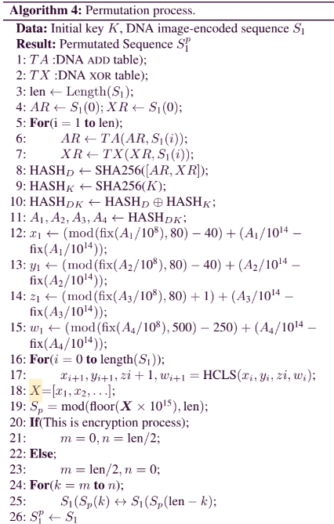
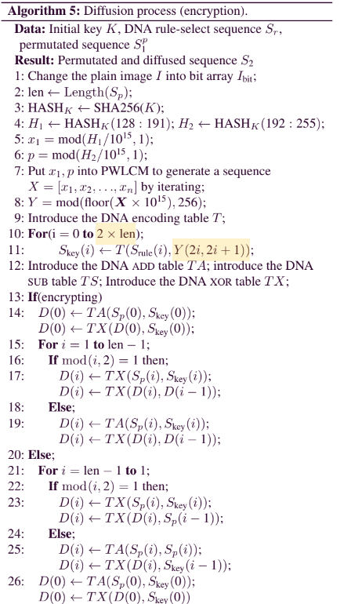

Slide 13
EXPERIMENTAL RESULTS:
DATASETS USED :- We have used ChestXray-14, COVID-CT, and fcon_1000 as our datasets.
ChestX-ray14 is a medical imaging dataset, which comprises 112 120 1024 × 1024 × 8 b single-channel frontal-view X-ray images of 30,805 unique patients.
The COVID-CT dataset has 349 CT images containing clinical findings of COVID-19 from 216 patients. These CT images have no specific size, but are also 8-b single-channel gray images.
Fcon_1000 contains a large number of brain magnetic resonance imaging (MRI) images. In our experiment, they are converted into 8-b gray images for processing.
KEYSPACE :- Keyspace is the set of all valid, possible, and distinct keys of a given cryptosystem. Different cipher algorithms usually have different limit to the number of keys by their encryption rules. To resist a brute-force attack, the keyspace is required be large enough, no less than 2100. There are the following two circumstances for the keyspace:-
The internal keys of our cryptosystem are two parameters p ∈ (0, 0.5) and two initial values x1 ∈ (0, 1) of two PWLCM and four initial values:
a) x1 ∈ (−40, 40) b) y1 ∈ (−40, 40) c) z1 ∈ (1, 81) d) w1 ∈ (−250, 250), of the HCLS system.

Slide 14
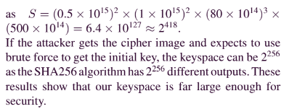
Calculation of KEYSPACE of RC-DNA:

Slide 15
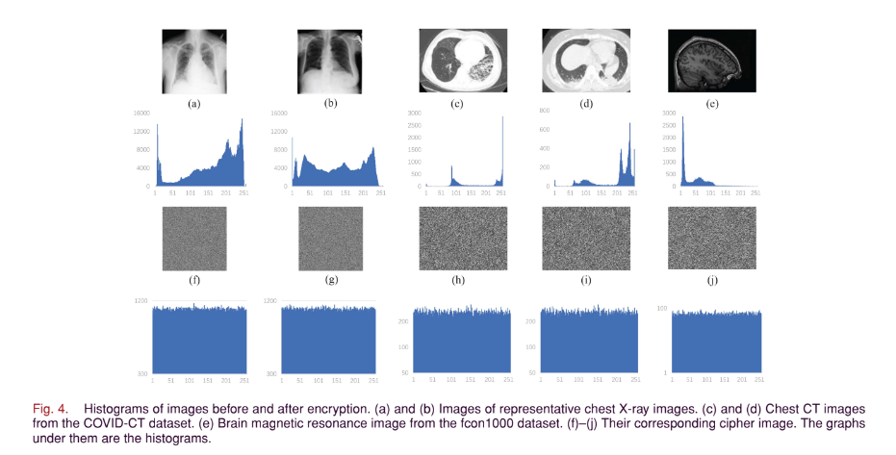
HISTOGRAM ANALYSIS :

Slide 16
A histogram at each gray level reflects statistical indiscernibility of a cipher image.
The test plain images are shown in Fig. 4(a)–(e), and the corresponding cipher images in Fig. 4(f)–(j). It can be seen that the noise-like cipher image greatly hides the information of the image, making it difficult for attackers to obtain valid information through cipher images. Therefore, the proposed
RC-DNA can resist statistical analysis attacks.
The greater the noise-like behavior, the more random is the cipher image and better is the encryption performed and therefore it becomes almost resistant to attacks through brute force.

Slide 17
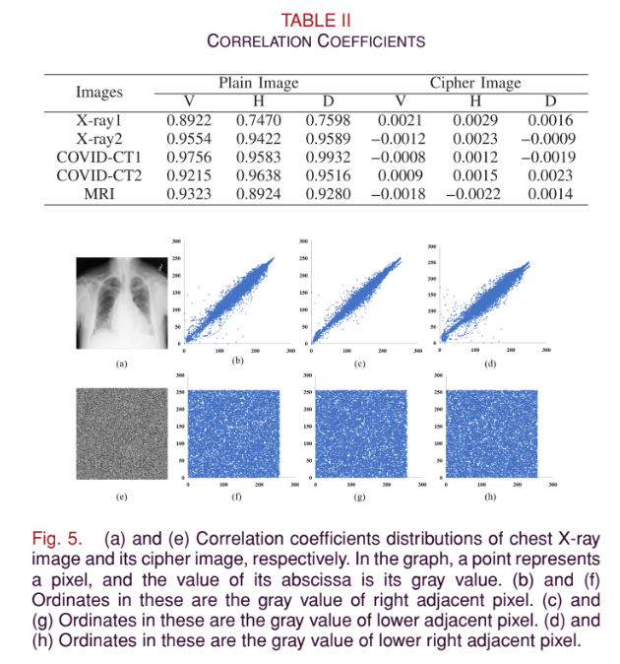
Pixel Correlation Analysis
In the field of image encryption, pixel correlation refers to the similarity between adjacent pixels. Images tend to have unique characteristics of strong correlation between adjacent pixels. And, encryption methods need to break the correlation to improve security.
The correlation coefficients of some images and their distributions are shown :

Slide 18
The results show that the plain images have strong correlation between adjacent pixels in different directions, while the corresponding cipher image almost has no correlation. Also, the figure displays the comparison of correlation of the image before and after encryption.
Our algorithm successfully breaks the correlation between adjacent pixels. This is mainly due to the randomness of the proposed DNA encoding process and the permutation algorithm.
Information entropy is a measure of data uncertainty that can reflect the diffusion performance of an image cryptosystem.Generally, the greater the entropy of the cipher image is, the harder it will be for the attacker to crack.
The information entropy of the 8-b encrypted images by our proposed cryptosystem is close to 8, indicating that it has good diffusion performance.
We also calculate the sensitivity of the system and find that our system if immune to differential attacks where
the attacker changes the value of a pixel or several pixels in the plain image, and compares the difference
between two corresponding cipher images.
Sensitivity calculation is based on 2 parameters : (a) NPCR (number of pixels change rate) and
UACI(unified average changing intensity).

Slide 19
CONCLUSION:
To ensure the security of cipher images, we have proposed a novel cryptosystem for secure healthcare with two effective modules:
1) randomly DNA encoding module 2) content-aware permutation and diffusion module.
The former one builds a random encryption rule selector in DNA encoding process, which increases security by building quantity of random map-pings from image pixels to computations and greatly improves key sensitivity.
The latter module constructs a permutation sequence, which not only encodes information of pixel values, but also breaks the strong correlation between adjacent pixels located in a patch.
Due to the character of high-speed and parallelism, DNA computing has advantage of encrypting large numbers of image data.
If this model can be large scale applied in IoT in the future, with the support of high-performance software and hardware dedicated to DNA computing, the speed of our algorithm can be
higher.

